Slide 1
EECS 498 System Design of a Search Engine
Winter 2026
Lecture 16: The query compiler
Nicole Hamilton
https://web.eecs.umich.edu/~nham/
nham@umich.edu

Slide 2
agenda
details
name the octopus!
TDRD parsing
the query compiler

Slide 3
agenda
details
name the octopus!
TDRD parsing
the query compiler

Slide 4
details
Midterm course eval reports posted to Canvas. Most of you were pretty happy and you liked the AG homework assignments.
  Some thought we spent too much time on OS concepts they already knew while others reported that without 482, it’s been difficult.
  A surprising refreshing number of you liked creating your own STL.
Still need to finish the robots.txt assignment.
  Adding sitemap:.
  Clarification on priority: If two directives apply equally, choose the one from a rule that specifies a literal user-agent over one that specified *.
  May release an early version of the starter files for you to work on before the AG is up.
Working on finalizing how to order a tee shirt.

Slide 5
agenda
details
name the octopus!
TDRD parsing
the query compiler

Slide 6
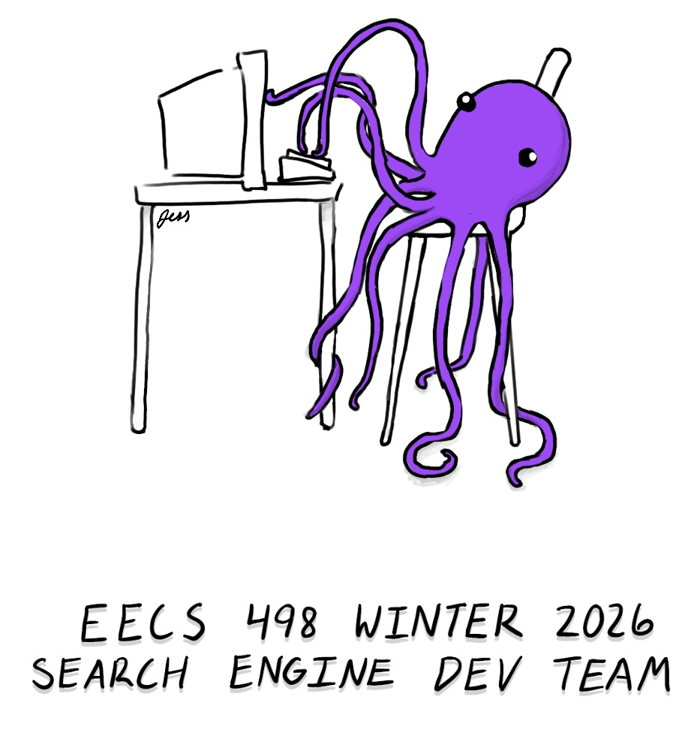

We have a design, thanks to Jess Morton.
Front
Back

Slide 7
any we should add to the survey?
Octothorpe
Jeff
Zork
tf/idf
Purple
Sami
Carlos
Rahul
Jess
So Cute
Searchy
Rose
Gilbert
George
Octavious
Hamilton
Purelle
Nicky
Squishy
Seashell
Ultros

Slide 8
agenda
details
name the octopus!
TDRD parsing
the query compiler

Slide 9
the compiler problem
Need a way to compile a query into a structure of ISRs that can be passed to the constraint solver.
Both are recursive and they match one-to-one.
To solve this, we’ll introduce some notation and a parsing technique called top-down recursive descent (TDRD).

Slide 10
The query language and the ISRs can be recursive
"apollo moon landing" | ( apple banana )
OR
The parse tree
Phrase
AND
"apollo"
"moon"
"landing"
"apple"
"banana"

Slide 11
The query language and the ISRs can be recursive
"apollo moon landing" | ( apple banana )
OR ISR
The ISR structure
Phrase ISR
AND ISR
apollo ISR
moon ISR
landing ISR
apple ISR
banana ISR

Slide 12
"apollo moon landing" | ( apple banana )
The trees are the same.
OR
The parse tree
Phrase
AND
"apollo"
"moon"
"landing"
"apple"
"banana"
OR ISR
The ISR structure
Phrase ISR
AND ISR
apollo ISR
moon ISR
landing ISR
apple ISR
banana ISR

Slide 13
two parts to compiling
Tokenizing the input to recognize keywords, literals, operators and variable names. For example, in C++:
"a=b->c" → { "a", "=", "b", "->", "c" }
Parsing the stream of tokens to recognize the language constructs, compiling that into an executable or evaluable form.

Slide 14
Tokenizing
Can be quite simple, e.g., breaking on white space or special characters.
#include <iostream>
using namespace std;
int main( )
{
string token;
while ( cin >> token )
{
// ...
}
}

Slide 15
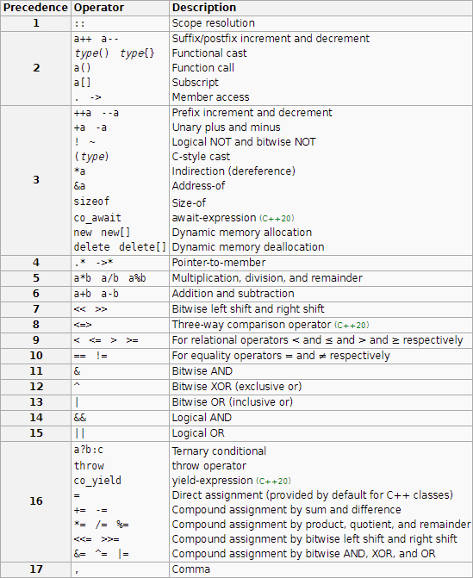
But most languages, like C++, have lots of operators of differing precedence and they can be run together.
The tokenizer has to separate and recognize them.

Slide 16
The tokenizer produces a stream of tokens you can examine, consume (take), or consume only if it matches what you’re looking for (match).
class TokenStream
{
public:
Token *CurrentToken( );
Token *TakeToken( );
bool Match( TokenType t );
TokenStream( );
TokenStream( char *filename );
TokenStream( ifstream &is );
private:
ifstream input;
string currentTokenString;
Token *currentToken;
};

Slide 17
An example taken (sort of) from my C shell’s parser
enum TokenType
{
TokenInvalid = -1, TokenEOF = 0,
TokenNotBuiltin,
TokenPlus, TokenNOT, TokenMinus, TokenDoubleQuote, ...
};
class Token
{
public:
virtual TokenType GetTokenType( ) const;
virtual char *TokenString( ) const
{
return nullptr;
}
};
class NotBuiltin : Token
{
public:
TokenType GetTokenType( ) const
{
return TokenNotBuiltin;
}
char *TokenString( ) const
{
return string;
}
private:
char *string;
};

Slide 18
An example taken (sort of) from my C shell’s parser
// Constructors for reserved words and tokens that define the symbolic
// name, the string representation, and the TokenType value.
// (Missing value mean add one to the previous value.)
Token( TokenInvalid, NULL, = -1 ),
Token( TokenEOF, NULL, = 0 ),
Token( TokenNotBuiltin, NULL, ),
Token( TokenPlus, "+", ),
Token( FirstToken, NULL, = TokenPlus ),
Token( FirstOperator, NULL, = FirstToken ),
Token( TokenNOT, "NOT", ),
Token( TokenMinus, "-", = TokenNOT ),
Token( TokenDoubleQuote, "\"", ),
Token( TokenLeftParenthesis, "(", ),
Token( TokenRightParenthesis, ")", ),
Token( TokenLeftBracket, "[", ),
Token( TokenRightBracket, "]", ),
Token( TokenAnd, "&&", ),
Token( TokenOr, "||", ),
Token( TokenOR, "OR", = TokenOr ),
Token( TokenVerticalBar, "|", = TokenOR ),
Token( TokenColon, ":", ),
Token( TokenEqual, "=", )
Token( TokenMultiply, "*", ),
Token( TokenDivide, "*", ),

Slide 19
two basic approaches to parsing
Bottom-up: Uses a stack and a machine generated comparison table that decides, based on the top of the stack and the next token, whether to
  Push the token onto the stack or
  Do a reduction on the top items, replacing them with something else and emitting some code to implement whatever language construct was just recognized.
  Typically written with a "compiler compiler", e.g., YACC / LEX or BISON / Flex. LEX and Flex do tokenizing. YACC and BISON recognize the language.
Top-down recursive descent (TDRD): Uses recursive functions that look for each of the language constructs. Instead of an explicit stack, it uses the call stack to look for matches. Usually hand-written.

Slide 20
top-down recursive descent
I happen to like this strategy and used it in my C shell and at Microsoft on both the search engine query compiler and for SQL parser for Windows Update.
It involves no dependencies on tools.
It's quite fast.
The code is pretty easy to read and naturally expresses precedence in the language.
Lots of opportunity to special-case the parsing if need be.
Only disadvantage is you have to write a procedure for every construct in the language.

Slide 21
BNF
Need a way of describing what constitute legal constructs in the language.
Usually written in Backus-Naur form (BNF).
<Sentence> ::= <Noun> <Verb> "."
<Noun> ::= "Cats" | "Dogs"
<Verb> ::= "meow" | "bark"

Slide 22
BNF
Backus-Naur Form or Backus-normal Form.
Notation for describing the syntax a recursive language with a set of possible tokens.
Consists of a set of rules that describe allowable sequences of tokens and how they can be combined into higher-lever constructs.
Each rule is called a production.
<Sentence> ::= <Noun> <Verb> "."
<Noun> ::= "Cats" | "Dogs"
<Verb> ::= "meow" | "bark"

Slide 23
BNF
::= means the LHS is composed of the sequence elements on the right.
a | b means either a or b is a match.
<Sentence> ::= <Noun> <Verb> "."
<Noun> ::= "Cats" | "Dogs"
<Verb> ::= "meow" | "bark"

Slide 24
BNF
What sentences are allowed?
Are all of them sensible?
Are some sentences not allowed?
<Sentence> ::= <Noun> <Verb> "."
<Noun> ::= "Cats" | "Dogs"
<Verb> ::= "meow" | "bark"

Slide 25
BNF
Just because the syntax allows you to write something doesn’t mean it’s guaranteed to be sensible.
<Sentence> ::= <Noun> <Verb> "."
<Noun> ::= "Cats" | "Dogs"
<Verb> ::= "meow" | "bark"

Slide 26
BNF
Legal sentences:
Cats meow.
Cats bark.
Dogs meow.
Dogs bark.
but cats don’t bark and dogs don’t meow.
Not a sentence:
Birds tweet.
<Sentence> ::= <Noun> <Verb> "."
<Noun> ::= "Cats" | "Dogs"
<Verb> ::= "meow" | "bark"

Slide 27
BNF
BNF allows for repetition and recursion.
{ … } means zero or more repetitions.
Notice how this example creates precedence.
Is multiplication done before or after addition?
<Add> ::= <Multiply> { "+" <Multiply> }
<Multiply> ::= <Base> { "*" <Base> }
<Base> ::= "(" <Add> ")" | <Literal>
<Literal> :: an integer string

Slide 28
BNF
Notice how this creates precedence.
How would these be parsed?
5 + 3 * 4 + 6
5 +
* 4
hello
<Add> ::= <Multiply> { "+" <Multiply> }
<Multiply> ::= <Base> { "*" <Base> }
<Base> ::= "(" <Add> ")" | <Literal>
<Literal> :: an integer string

Slide 29
BNF
Complete notation:
<x> ::= <y> <z> <x> is composed of a <y> followed by a <z>.
<x> ::= <y> | <z> <x> is composed of either a <y> or a <z>.
<x> ::= <y> [ <z> ] <x> is composed of a <y> followed by an optional <z>.
<x> ::= <y> { <z> } <x> is composed of a <y> followed by zero or more <z>.
elements.
<x> ::= "c" <x> is a literal string, specified between the quotes.

Slide 30
operator precedence
Consider typical C/C++ operator precedence.
( )
* / %
+ -
< <= >= >
== !=
&&
||

Slide 31
rules are written in reverse of the desired precedence
( )
* / %
+ -
< <= >= >
== !=
&&
||
<OrExpression> ::= <AndExpression> { '||' <AndExpression> }
<AndExpression> ::= <EquateExpression> { '&&’ <EquateExpression> }
<EquateExpression> ::= <RelateExpression> { <EquateOp> <RelateExpression> }
<EquateOp> ::= '==' | '!='
<RelateExpression> ::= <AddExpression> { <RelateOp> <AddExpression> }
<RelateOp> ::= '<' | '<=' | '>=' | '>'
<AddExpression> ::= <MultiplyExpression> { <AddOp> <MultiplyExpression> }
<AddOp> ::= '+' | '-'
<MultiplyExpression> ::- <BaseExpression> { <MultiplyOp> <BaseExpression> }
<MultiplyOp> ::= '*' | '/' | '%’
<BaseExpression> ::= '(‘ <BaseExpression> ')' | <Literal>
<Literal> ::= an integer string

Slide 32
rules are written in reverse of the desired precedence
Each rule gets turned into a procedure that tries to match that target on the input stream.
<OrExpression> ::= <AndExpression> { '||' <AndExpression> }
<AndExpression> ::= <EquateExpression> { '&&’ <EquateExpression> }
<EquateExpression> ::= <RelateExpression> { <EquateOp> <RelateExpression> }
<EquateOp> ::= '==' | '!='
<RelateExpression> ::= <AddExpression> { <RelateOp> <AddExpression> }
<RelateOp> ::= '<' | '<=' | '>=' | '>'
<AddExpression> ::= <MultiplyExpression> { <AddOp> <MultiplyExpression> }
<AddOp> ::= '+' | '-'
<MultiplyExpression> ::- <BaseExpression> { <MultiplyOp> <BaseExpression> }
<MultiplyOp> ::= '*' | '/' | '%’
<BaseExpression> ::= '(‘ <BaseExpression> ')' | <Literal>
<Literal> ::= an integer string

Slide 33
Rules are written in reverse of the desired precedence
The grammar is recursive but only right-recursive.
No production has the target as the first component of itself.
<OrExpression> ::= <AndExpression> { '||' <AndExpression> }
<AndExpression> ::= <EquateExpression> { '&&’ <EquateExpression> }
<EquateExpression> ::= <RelateExpression> { <EquateOp> <RelateExpression> }
<EquateOp> ::= '==' | '!='
<RelateExpression> ::= <AddExpression> { <RelateOp> <AddExpression> }
<RelateOp> ::= '<' | '<=' | '>=' | '>'
<AddExpression> ::= <MultiplyExpression> { <AddOp> <MultiplyExpression> }
<AddOp> ::= '+' | '-'
<MultiplyExpression> ::- <BaseExpression> { <MultiplyOp> <BaseExpression> }
<MultiplyOp> ::= '*' | '/' | '%’
<BaseExpression> ::= '(‘ <BaseExpression> ')' | <Literal>
<Literal> ::= an integer string

Slide 34
Consider how we’d implement a parser and interpreter for part of this.
Start with simple notions of a tuple and a list of tuples.
(A tuple is a finite, ordered sequence of elements.)
class Tuple
{
public:
Tuple *Next;
TokenType Operation;
virtual int Eval( );
Tuple( );
virtual ~Tuple( );
}
class TupleList : Tuple
{
public:
Tuple *Top,
*Bottom;
void Append( Tuple *t );
TupleList( );
~TupleLIst( );
}

Slide 35
// <AddExpression> ::= <MultiplyExpression> { <AddOp> <MultiplyExpression> }
//
// <AddOp> ::= '+' | '-'
TupleList *Parser::FindAddExpression( )
{
Tuple *e;
if ( e = FindMultiplyExression( )
{
TokenType t;
// Consume the next token if it's a + or a -.
while ( t = FindAddOp( ) )
{
AddExpression *a= new AddExpression( t );
a->Append( e );
if ( e = FindMultiplyExpression( ) )
{
a->Append( e );
e = a;
}
else
{
delete a;
return nullptr;
}
}
return e;
}

Slide 36
// <AddExpression> ::= <MultiplyExpression> { <AddOp> <MultiplyExpression> }
//
// <AddOp> ::= '+' | '-'
class AddExpression : TupleList
{
public:
TokenType Operation;
int Eval( )
{
int sum = 0;
switch ( Operation )
{
case TokenPlus:
for ( Tuple *t = top; t; t = t->Next )
sum += t->Eval( );
break;
case TokenMinus:
for ( sum = t->Eval( ), t = t->Next; t; t = t->next )
sum -= t->Eval( );
}
return sum;
}
TupleType GetType( ) const
{
return TT_AddExpression;
}
}

Slide 37
// <MultiplyExpression> ::- <Expression> { <MultiplyOp> <Expression> }
//
// <MultiplyOp> ::= '*' | '/' | '%'
TupleList *Parser::FindMultiplyExpression( )
{
Tuple *e;
if ( e = FindExression( )
{
TokenType t;
// Consume the next token if it's an *, /, or %.
while ( t = FindMultiplyOp( ) )
{
MultiplyExpression *m = new MultiplyExpression( t );
m->Append( e );
if ( e = FindBaseExpression( ) )
{
m->Append( e );
e = a;
}
else
{
delete a;
return nullptr;
}
}
return e;
}

Slide 38
// <MultiplyExpression> ::- <BaseExpression> { <MultiplyOp> <BaseExpression> }
//
// <MultiplyOp> ::= '*' | '/' | '%'
class MultiplyExpression : TupleList
{
public:
int Eval( )
{
int result = 0;
switch ( Operation )
{
case TokenMultiply:
for ( Tuple *t = top; t; t = t->Next )
result *= t->Eval( );
break;
case TokenDivide:
for ( result = t->Eval( ), t = t->Next; t; t = t->next )
result /= t->Eval( );
break;
case TokenModulo:
for ( result = t->Eval( ), t = t->Next; t; t = t->next )
result %= t->Eval( );
}
return result;
}
TupleType GetType( ) const
{
return TT_MultiplyExpression;
}
TokenType Operation;
}

Slide 39
agenda
details
TDRD parsing
the query compiler

Slide 40
query language
Basic requirements are very simple.
Individual words.
Phrases in double quotes.
AND, OR and NOT.
Parenthesis.
Average query on Bing about 2.4 words in 2004. With LLMs interpreting queries today, they’re probably longer now.

Slide 41
simple search engine query language
<Constraint> ::= <BaseConstraint> { <OrOp> <BaseConstraint> }
<OrOp> ::= 'OR' | '|' | '||'
<BaseConstraint> ::= <SimpleConstaint> { [ <AndOp> ] <SimpleConstraint> }
<AndOp> ::= 'AND' | '&' | '&&'
<SimpleConstraint> ::= <Phrase> | <NestedConstraint> |
<UnaryOp> <SimpleConstraint> |
<SearchWord>
<UnaryOp> ::= '+' | '-' | 'NOT'
<Phrase> ::= '"' { <SearchWord> } '"'
<NestedConstraint> ::= '(' <Constraint> ')'

Slide 42
class QueryParser
{
public:
Token *FindNextToken( );
Tuple *FindConstraint( );
bool FindOrOp( );
Tuple *FindBaseConstraint( );
bool FindAndOp( );
Tuple *FindSimpleConstraint( );
Tuple *FindPhrase( );
Tuple *FindNestedConstraint( );
Tuple *FindSearchWord( );
QueryParser( char *query );
};
class Tuple
{
public:
virtual ISR *Compile( );
};
class Constraint : Tuple
{
ISR *Compile( );
}

